Slide 2
function
A function is a group of statements that together perform a task.
Every C program has at least one function, which is main(), and all the most trivial programs can define additional functions.
You can divide up your code into separate functions

Slide 3


Function Declarations
A function declaration tells the compiler about a function name and how to call the function.
The actual body of the function can be defined separately.

Slide 4

Defining a Function

Slide 5
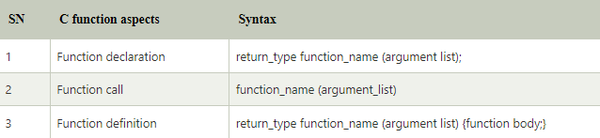

Slide 6
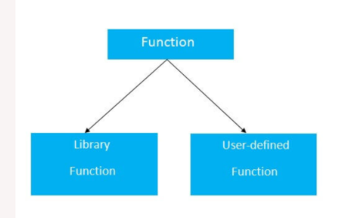

Slide 7
Library Functions: are the functions which are declared in the C header files such as scanf(), printf(), gets(), puts(), ceil(), floor() etc.
User-defined functions: are the functions which are created by the C programmer, so that he/she can use it many times. It reduces the complexity of a big program and optimizes the code.

Slide 8
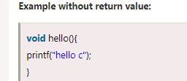
Return Value
A C function may or may not return a value from the function. If you don't have to return any value from the function, use void for the return type.

Slide 9
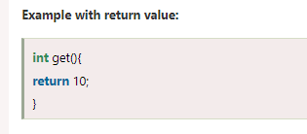

Slide 10
Different aspects of function calling
A function may or may not accept any argument. It may or may not return any value. Based on these facts, There are four different aspects of function calls.
function without arguments and without return value
function without arguments and with return value
function with arguments and without return value
function with arguments and with return value

Slide 11
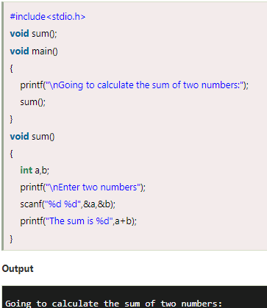
Function without argument and return value

Slide 12
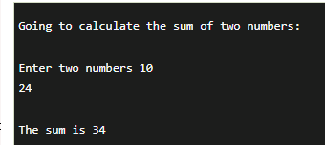

Slide 13
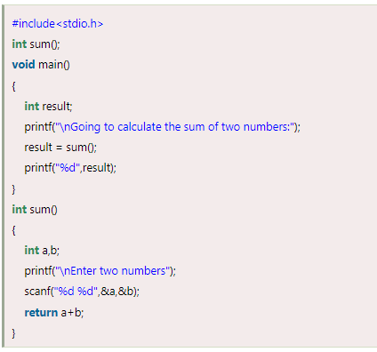
Function without argument and with return value

Slide 14
